Slide 1
Microstrip Patch Antena
Sam Harkness
EELE 533-2018

Slide 2
Overview
Physical Design
S-Parameter Simulation
Far-Field Simulation
Fabrication
S11 Measurements

Slide 3
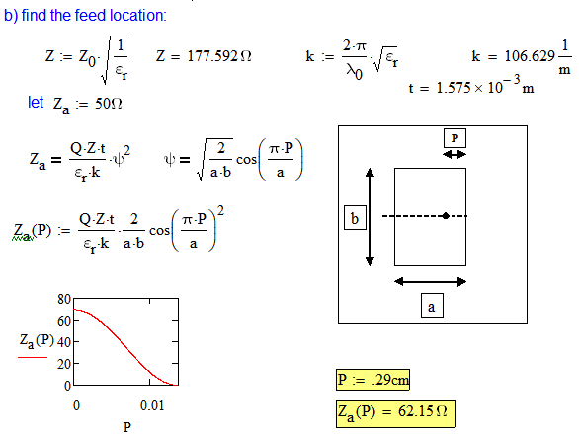
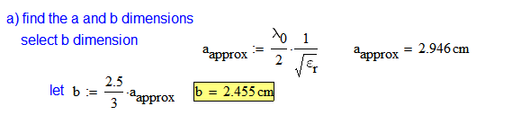
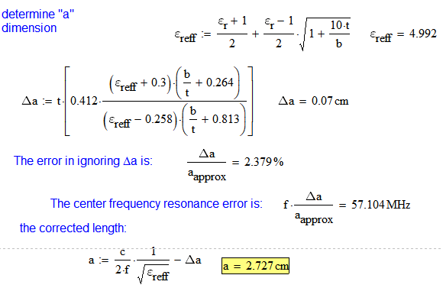
Physical Design

Slide 4
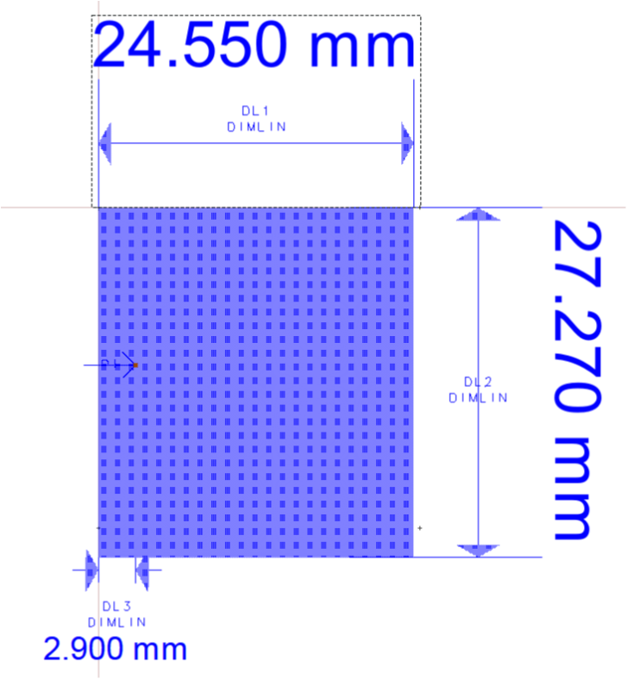
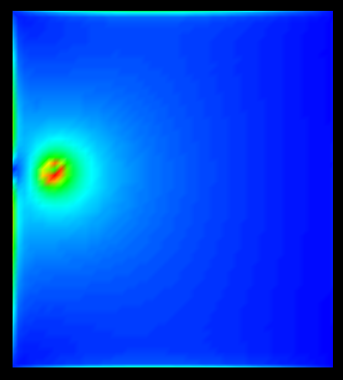
Physical Design

Slide 5
S-Parameter Simulation

Slide 6
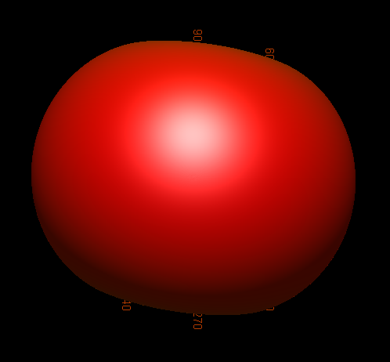
Far-Field Simulations - Azimuth

Slide 7
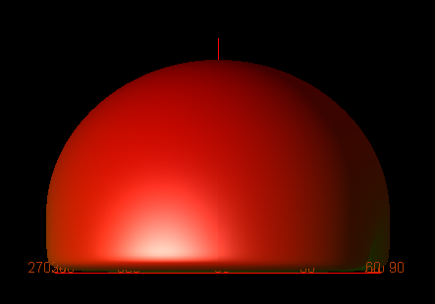
Far Field Simulations - Elevation

Slide 8
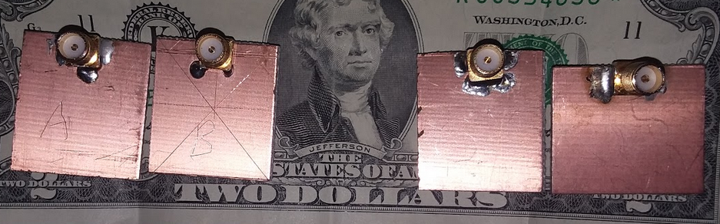
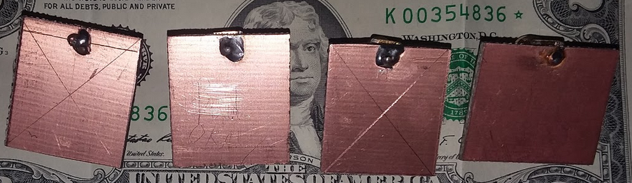
Fabrication

Slide 9
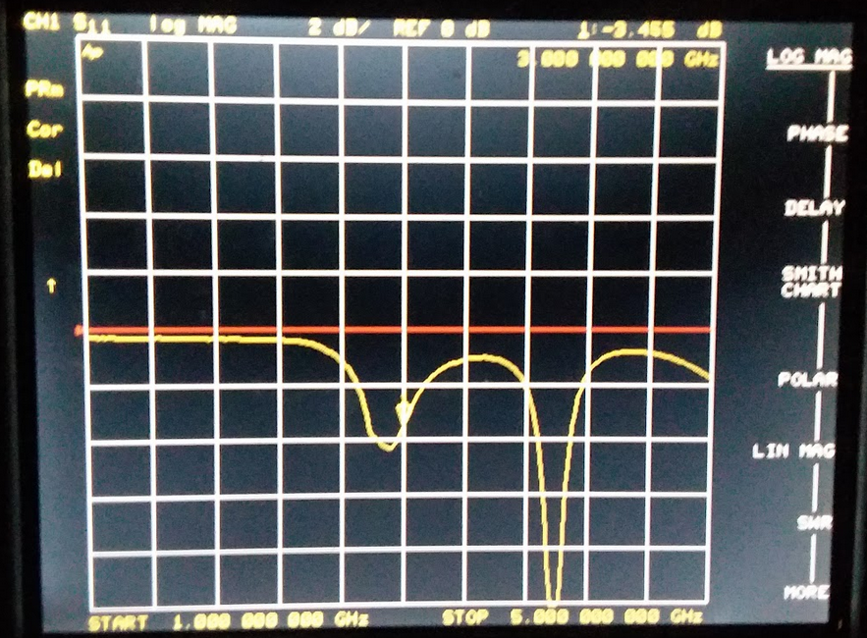
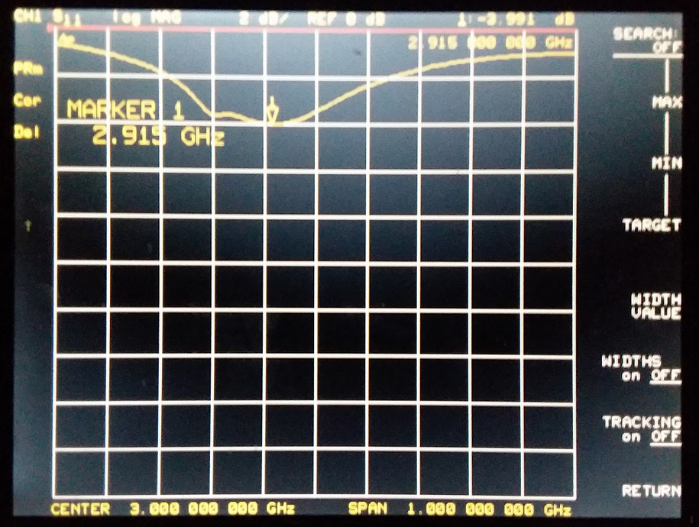
S11 Measurements - A

Slide 10
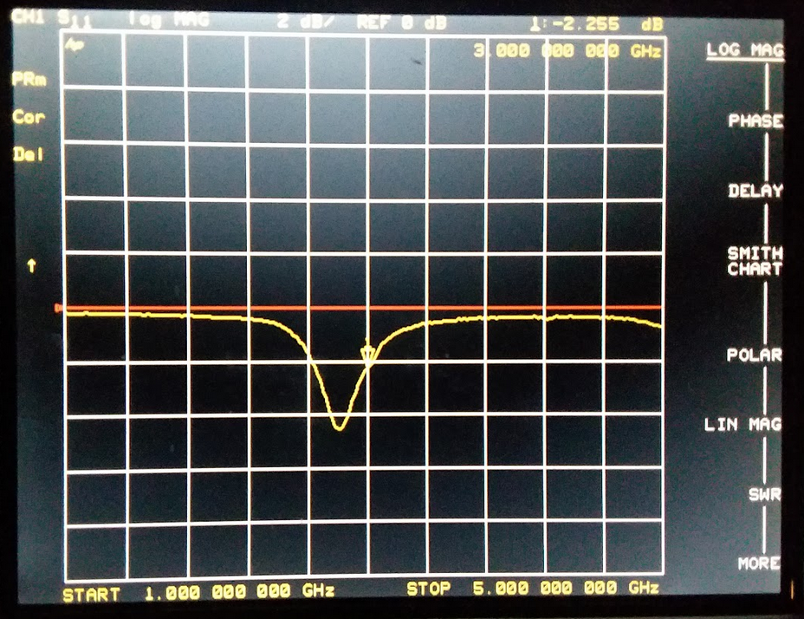
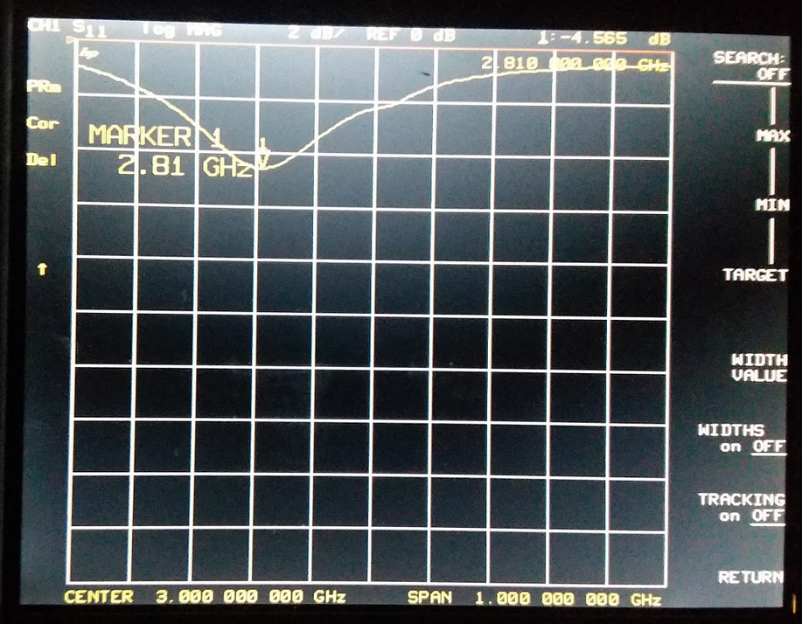
S11 Measurements - B

Slide 11
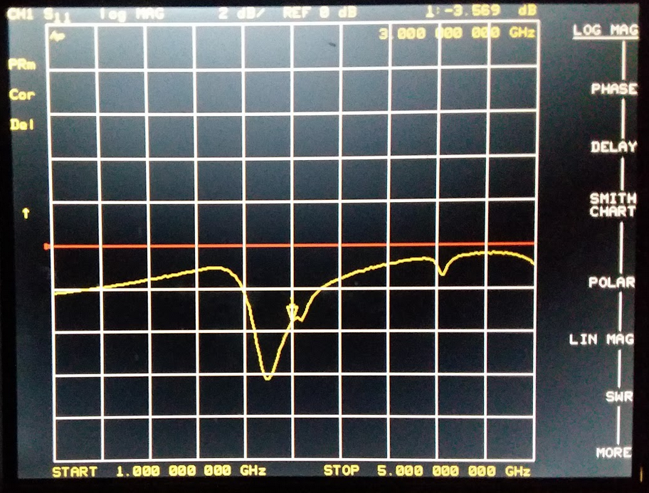
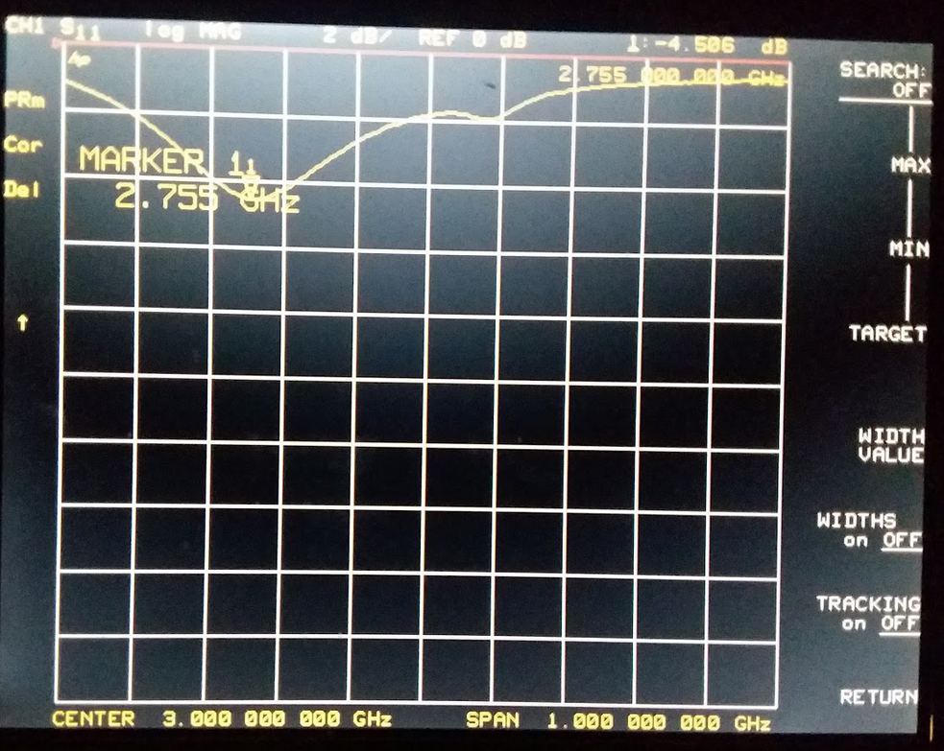
S11 Measurements - C

Slide 12
Conclusion
Physical Design
S-Parameter Simulation
Far-Field Simulation
Fabrication
S11 Measurements

